Slide 1
CAR 143913175 Exemplary
Notes:
I would like us to look at CAR 143913175 today as an example of an exemplary CAR.

Slide 2
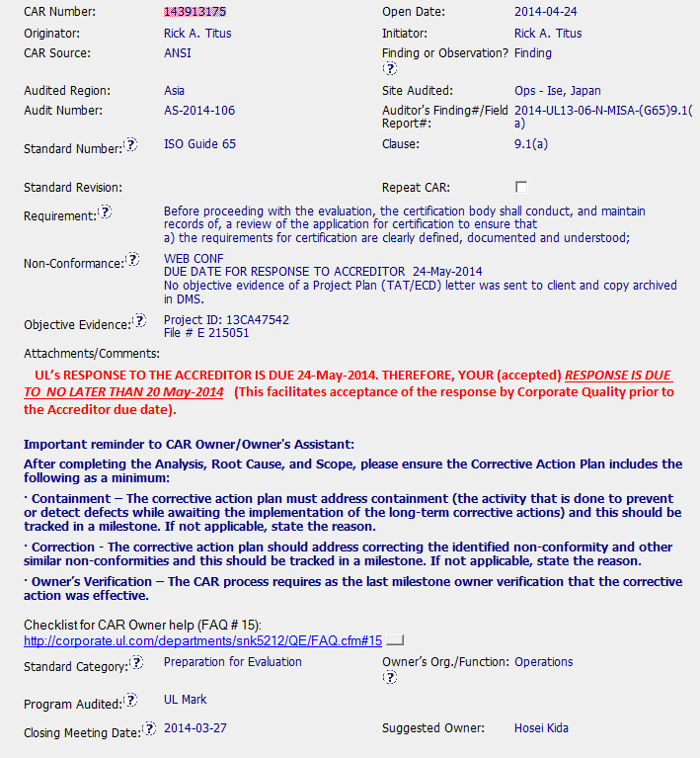
TAT (Turn Around Time)
ECD (Estimated Completion Date)
Accreditor due date and response date are clearly stated.
Very helpful instructions to the CAR Owner.
Great link for the CAR Owner .
Notes:
Two acronyms new to me in this CAR are TAT (Turn Around Time) and ECD (Estimated Completion Date). The CAR Champion included some very helpful guidance for the CAR Owner to create their initial response.

Slide 3
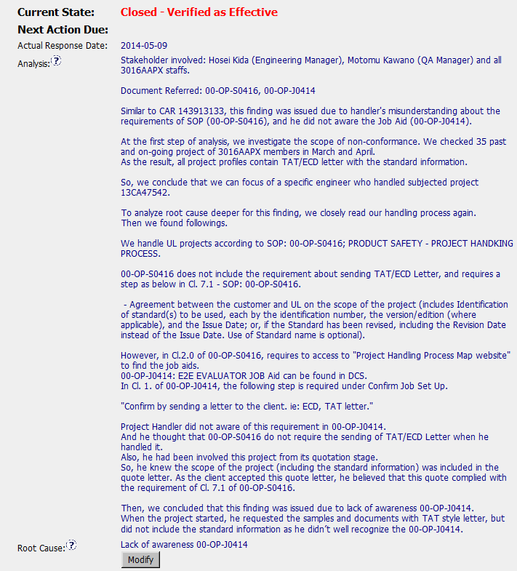
Stakeholders identified by name and title in Analysis
Good cross reference to other related CAR.
Good detail of how scope was determined.
Why were they not aware? Lack of proper training/review program?
Concise root cause statement.
Notes:
The CAR Owner expended reasonable effort to identify the stakeholders in detail, note a similar CAR and determine the proper scope. They had a detailed Analysis that led to a concise root cause statement. Maybe should have asked one more “why” to prevent reoccurrence of the same issue in the future.

Slide 4
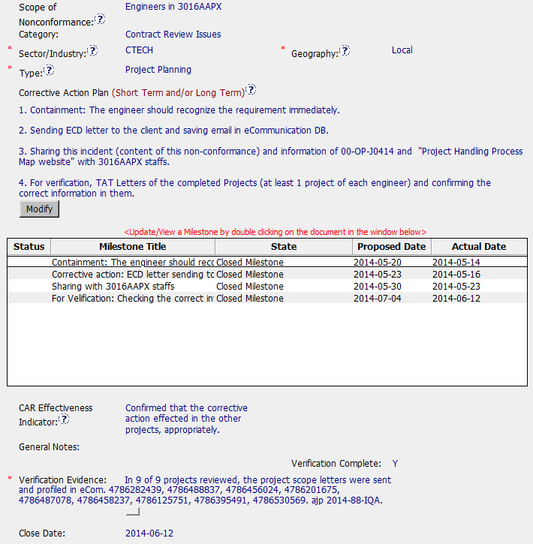
Concise Scope that is explained in Analysis.
Corrective action plan progresses logically.
Maybe should have updated training/review program.
Milestones correspond to elements of the corrective action plan.
Effectiveness Indicator is logical indication of good corrective actions.
Verification executed very quickly.
Notes:
Corrective Action Plan is logical and is supported with milestones for each major component. An evaluation of the training and review program might have been useful. The CAR was completed and verified within about 30 days from the initial response which would be refreshing.

Slide 5
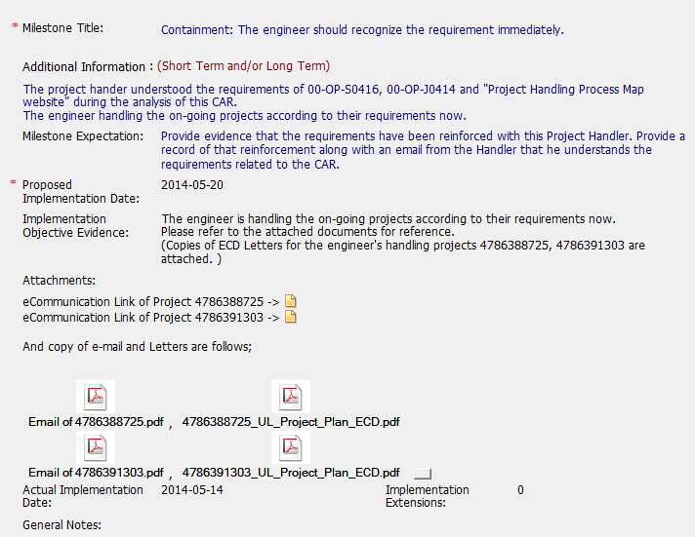
Not everyone has access to open links.
Notes:
In the first milestone some of the evidence was presented as links to eCommunication. Maybe anyone who would normally review this CAR would have eCommuniction access but some within UL do not have access (including myself). Would a screenshot be a better choice?

Slide 6
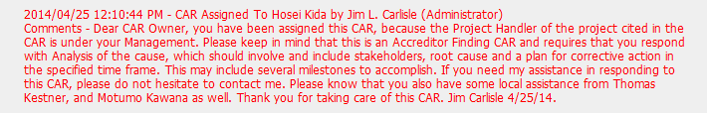

Good introduction to CAR Owner with genuine offer to help as needed. Included local resources for assistance which is key with time difference and language issues.
Even Michelangelo sometimes dropped his brush!
Notes:
The intro communication from CAR Champion to CAR Owner was excellent to provide guidance and offer help. Since this was a multicultural Champion/Owner it was key that local resources were noted for the CAR Owner. The CAR seemed to flow very nicely from intro to verification. BUT… Even Michelangelo sometimes dropped his brush!

Slide 7
CAR 143913175 – CBS Check
CBS Requirements | Excellent | Moderate | Need Improve | N/A
(C) Extensions are within requirement (<30 days, 3 or less) | X
(T) Most appropriate ‘category’, ‘type’, ‘geography’ are selected | X
(P) Facilitates the handling of disputed CARs |  |  |  | X
(T) Acts on CARs within required timeframe | X
(C) Analysis shows clear path to root cause and scope; stakeholders identified | X
(C) Root cause statement is succinct, reasonable, complete (Shows ‘N/A’ for observations) |  | X
(C) Corrective actions fix the objective evidence and other problems found; address entire root cause and scope. For observations, they do not go beyond fixing the objective evidence |  | X
(C) Milestones address containment & owner’s verification; completed per milestone expectations | X
(P) Verification per requirements | X
(L) Referenced communications are attached as needed | X
(C L) Evidence of communication for overdue/escalated CARs and other pertinent concerns |  |  |  | X
(P) Trains other CAR Champions | X
Notes:
The CAR Champion Critical Behaviors for Success were demonstrated very well. There is a possibility the Root Cause should have gone one more level to why the staff was not familiar with a key document for their process. Will this become a Zombie?

Slide 8

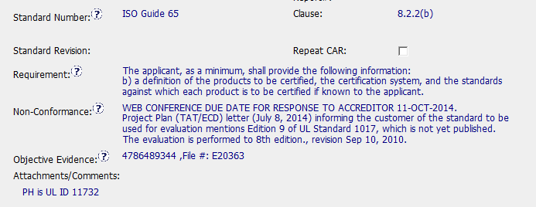
Exemplary - 143913780
ANSI CAR & Finding CAR
Requirements and Non-conformance are clear
Evidence is the project - Fabulous

Slide 9
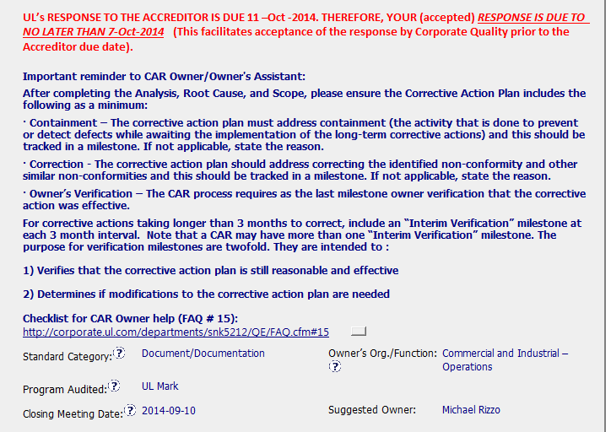
Information for the CAR Owner
Valuable information – including accreditor CAR information which may differ from other CARs.

Slide 10
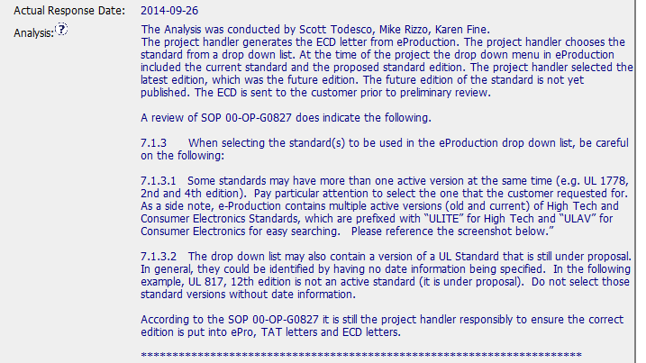

Analysis – part 1
Shows who took part in the analysis
Realized procedure was not followed, an documented the exact causes

Slide 11

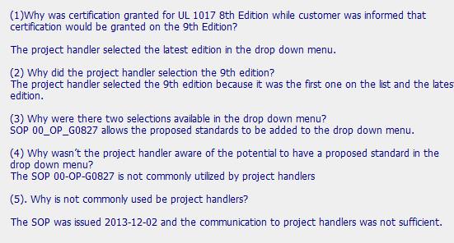
Analysis – part 2
Used the 5 Why’s and included the question and the answer - perfect

Slide 12

Root Cause
Root Cause was a result of the analysis, it flowed nicely from the analysis

Slide 13


Scope
Scope of the CAR can be seen in the projects they looked at for containment
Typically this is put in analysis, but it was allowed to be in the containment because they have two containment milestones.

Slide 14

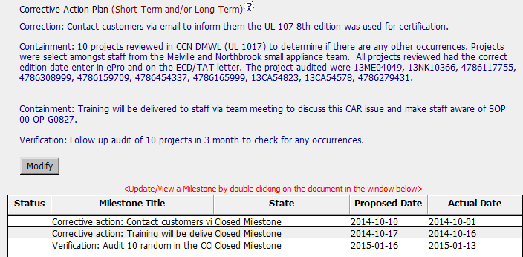
Milestones
Containment
Corrective Action
Verification

Slide 15

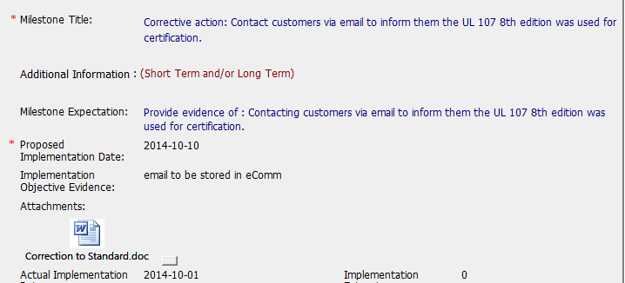
Corrective Action Milestone
Indicated the customer would be contacted, and the document to the customer is in the milestone

Slide 16
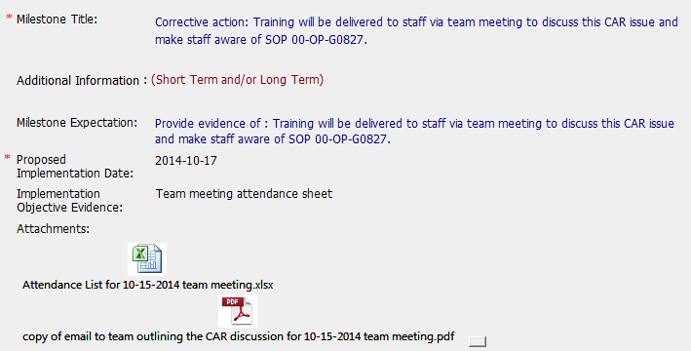

Training Milestone – part 1

Slide 17
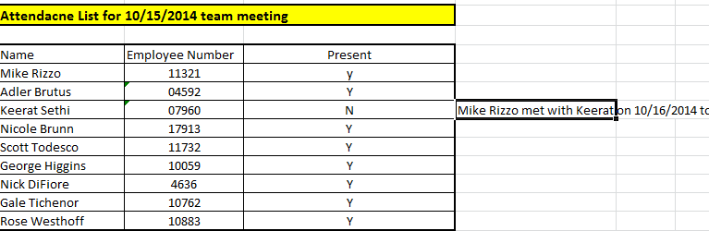

Training Milestone – part 2
Included was a list of who was trained including the person who was not there and how they got trained.

Slide 18

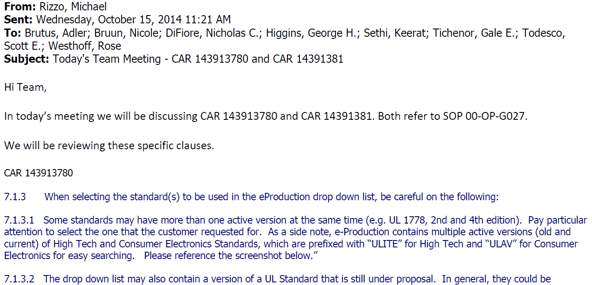
Training Milestone – part 3
Email shows exactly what was discussed and the CAR it pertained to

Slide 19

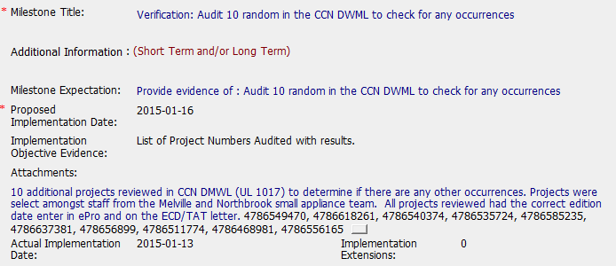
Verification Milestone
10 Random projects selected
Same CCN as the one in the CAR
Projects sampled were from different handlers

Slide 20



Other things to note
Effectiveness Indicator is good
No extensions were needed for this CAR
CAR Owner and CAR Champions worked well together

Slide 21
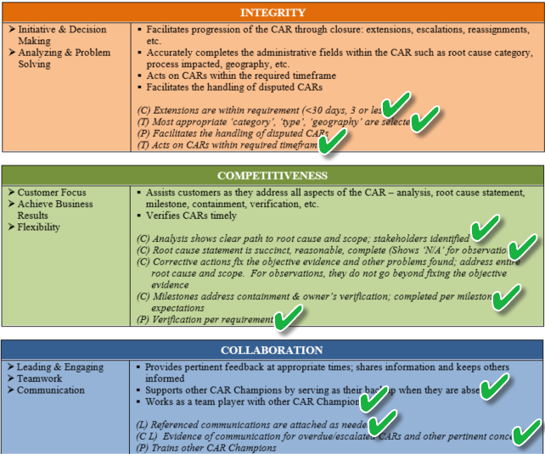
ECAR Admin CBS’s

